Slide 1

Voltage and Electricity
By Jatasya Raval

Slide 2
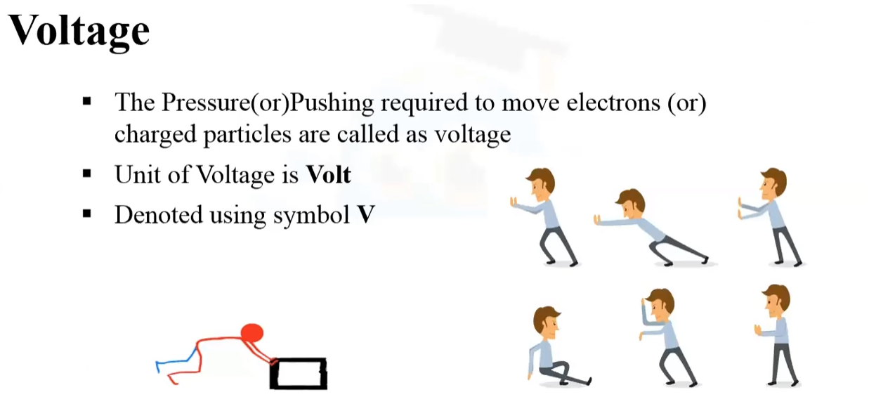

Slide 3
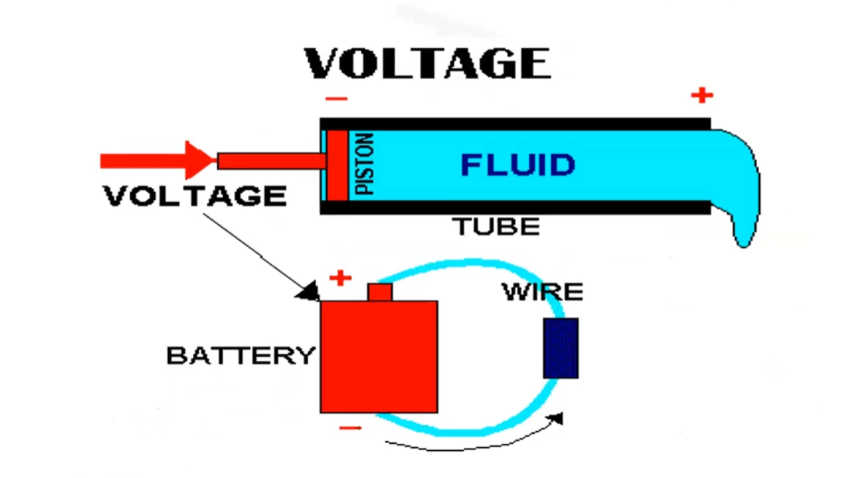

Slide 4
Thank You

